Slide 1
Chapter 11 Mission and Justice
Chapter Summary

Slide 2
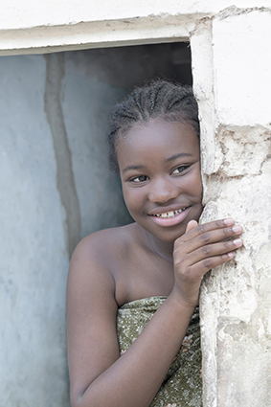
Summary
Catholic Social Teaching is grounded in the biblical understanding of justice and developed in the light of experiences of people in many different cultures.
It provides a set of key principles that can be used to evaluate situations, policies and approaches used in contemporary society. These often resonate with people of other faiths.

Slide 3
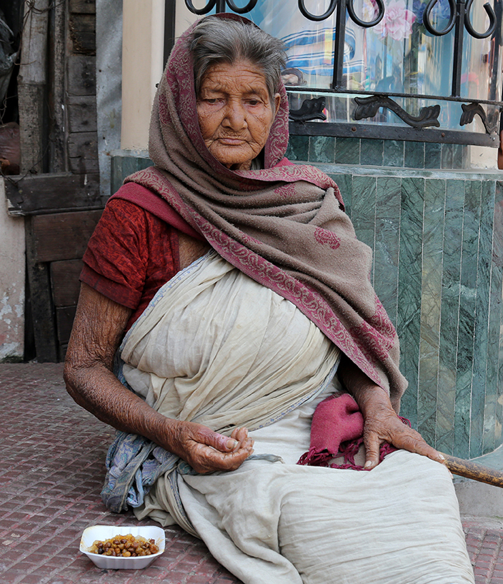
Summary
Since 1891 Catholic Social Teaching has developed ten key themes that include, Human Dignity, The Common Good and Community, Rights and responsibilities, Option for the Poor and Vulnerable, Participation, Dignity and Rights of workers, Stewardship of Creation, Global Solidarity and development, Constructive Role for government and Subsidiarity, Promotion of peace and disarmament.

Slide 4
Summary
The Common Good was described by Pope John XXIII as ‘the sum total of those conditions of social living whereby people are enabled more fully and readily to achieve their own perfection’.
The common good means that each person is connected to others and obligates them to work towards making the common good a reality.
It is not the common desires or interest of the majority, but the combined good.
As we live in a global society, the common good applies universally at both national and international levels.

Slide 5
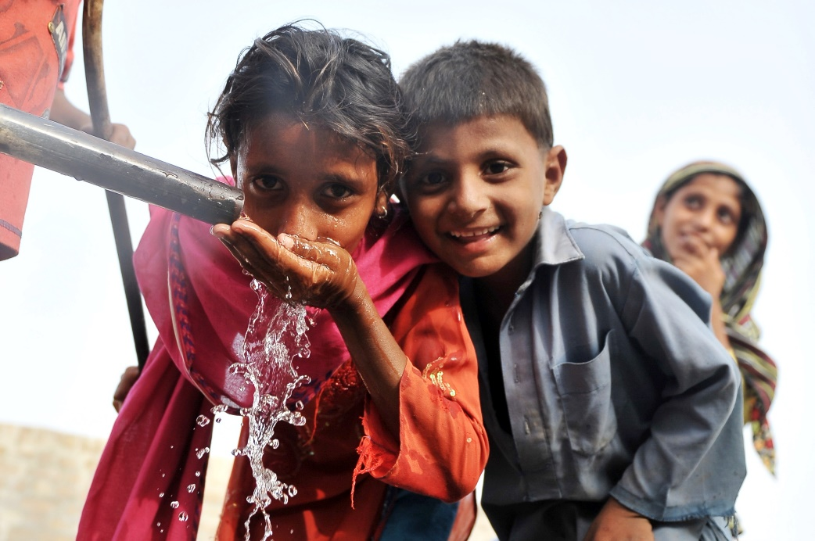
Summary
The common good enables humans to flourish. Wealthier nations need to support weaker nations so that they can develop without the burden of debt and high interest rates.
To be a steward means to take care of something, and to protect its value and be responsible for it.

Slide 6
Summary
Today stewardship is applied to the environment and was a central theme in both the Old and New Testament.
Stewardship is about a way of life that responds to the God-given gifts of the environment, that treats it with respect and sharing with others.

Slide 7
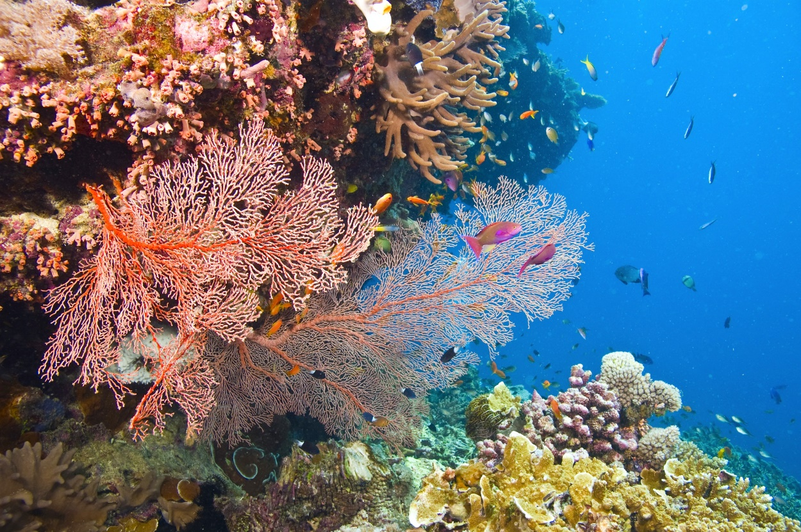
Summary
Stewardship in the Catholic church calls people to work for an equitable and sustainable future in which all people share in the goods of the earth and does not promote poverty, pollution or mismanagement of creation.

Slide 8
Summary
Catholic Earthcare is an agency of the Catholic Bishops Commission for Justice and Development to promote the understanding that creation is sacred and must be looked after for future generations.
Promotion of peace and disarmament dates back to the Gospel call of non-violence.
We are reminded of the significance of peace in the document Pacem in Terris (1963).
The document is an address to all people and is the first Vatican document to address the wider community.

Slide 9
Summary
The document is grounded in human rights and points out that governments have an obligation to pay attention to the needs of the vulnerable and that people should not live in fear.
The first resolution of the United Nations was to promote the elimination of weapons of mass destruction.
Pax Christi is an international Catholic organisation that works for peace in the world. In 1983 it was awarded the UNESCO Peace Education Prize.
Since 1990 the Jesuit Refugee Service has been working in Cambodia to deal with landmines and cluster munitions.
The aim of the campaign is to ban land mines.

Slide 10
Summary
Sr Denise Coghlan, a Brisbane Sister of Mercy, has been involved in the landmine campaign for more than 20 years.
One of the programs Sister Denise is involved in is a vocational training centre for people who have experienced the devastating effect of landmines.
There are a number of methods that can be used to analyse issues related to justice.
These can help reflect on what is happening in society.

Slide 11
Summary
See, Judge, Act is one method that was developed by Belgian Cardinal Joseph Cardijin who founded the young Christian Workers movement.
This model calls the individual to
See – explore facts of events and situations
Judge – examine the rights and wrongs relevant to the situation
Act – respond and act individually and as a group
The final stage is to review your actions to see what you have learnt from the process.

Slide 12
Activities
1. Divide your class into 10 groups. Each group is to take one of the 10 Catholic Social Teaching themes and design a poster that will be displayed within your school. On your poster, outline what the teaching is about and how it is relevant to young people today.
2. Australia has a long association with the United Nations and was one of the first signatories to the original charter.
Conduct some research to find out how involved Australia is within the UN, who our current ambassador to the UN is and what councils within the UN Australia is on.

Slide 13
Comprehension Test
1. Which teachings are grounded in the biblical understanding of justice and developed in light of experiences of people in many different cultures?
Catholic Social Teaching
2. When was Rerum Novarum proclaimed and what does it examine?
Social Factors and proclaimed social Justice
3. How many themes are there within Catholic Social Teachings?
10
4. What is the ‘Common Good’?
The decision which benefits the lives of the most

Slide 14
Comprehension Test
5. How can the global common good be realised?
By upholding the rights of people
6. What is a central motif in the Old and New Testament and calls for individuals to care for the earth?
Stewardship of Creation
7. Name the document issued in 1963 by Pope John XXIII that emphasised the worlds growing interdependence
Pacem in Terris

Slide 15
Comprehension Test
8. The letter entitled Let the Many Coastlands be Glad: A Pastoral Letter on the Great Barrier Reef was published by which Catholic group of people?
Catholic Bishops of Queensland
9. Which organisation was established in 2002 by the Catholic Bishops Commission for Justice and Develop to promote the understanding that creation is sacred and endangered?
Catholic Earth care australia
10. Name the three parts of the model developed by Belgian Cardinal Joseph Cardijin that encourages people to reflect on their situation.

Slide 16
Assignment
Many agencies such as Caritas Australia are working with communities in developing countries to help them become self sustaining.
Initiatives such as building wells, clothing and handicraft construction and community banks are some of the ways these agencies are helping people achieve full human dignity.
Many people in our community are not aware of these great initiatives or ways that they can help.
You are to conduct some research and then write up a report on Caritas, outlining what they do to help people attain self sufficiency.

Slide 17
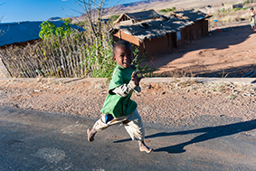
Assignment
In your report provide an outline of initiatives the organisation is doing to help people, where this is occurring and in your opinion if this is a worthwhile cause.

